Slide 1
Online Learning Course Scheduler
Marquies White
CIS129
12/18/2024

Slide 2
Overview
3
Introduction
5
Summary of Findings
7
Real World Applications
8
Design Approach
9
Solution Design Proposal
10
Open Questions
11
Works Cited

Slide 3
Introduction
I am a Learning and Development Coordinator at a non-profit organization in charge of supporting over 150 adult learners. I have experienced firsthand that adult learners can struggle with completing online learning content.
Online learning is a common way that adult learners develop their skills at work, but online learning has some advantages and disadvantages:
Advantages
Disadvantages
Self-paced
Flexible
Can utilize multimedia
Choice
Time Conflicts
Lack of Motivation
Procrastination
Some Computer Skills Required

Slide 4

Introduction
My Topic:
Create a program that will help adult learners create healthy habits around online learning with a particular focus on helping learners fit time to take online learning into their busy schedules.

Slide 5

Summary of Findings
Current research on online learning struggles
In an adult learning case study by Karlsen et al. (2023), several participants of the study said that a lack of time and competing priorities caused them to not take full advantage of their online learning (specifically microlearnings in this study).
Participants also noted that it was difficult to create a habit of online learning due to other pressing tasks such as meetings.

Slide 6
Summary of Findings
Current research on existing solutions
In the study by Karlsen et al. (2023), the only consistent way that participants said that they completed their online learnings is when it is mandated by their superiors.
In another online learning study, Sahin and Yurdugül (2022) shared that participants of their study said that reminders and notifications were helpful to get them to use the online learning platform.

Slide 7
Real World Applications
Fixing the online learning issue with...
Supervisor Mandates
This is not a true solution, as adult learners should not have to be required to complete online learning for their own development.
Reminders and Notifications
I believe that this is a step in the right direction and the basis of my program. Many adult learners believe they are far too busy to complete online learnings, so it is important to help them schedule time for learning.

Slide 8
Design Approach
My Program
I wanted to create a program that was simple, quick, and easy to use. Since the issue at hand is not having enough time to complete online learning, the solution to this issue needs to get its job done as simple as possible.
For my program, the user only needs to enter very basic information (Email, Date, Time, and Course Duration) which should take a minute or less. However, since the user enters this information themselves, it can help to motivate them to commit the date and time they are choosing to online learning.

Slide 9
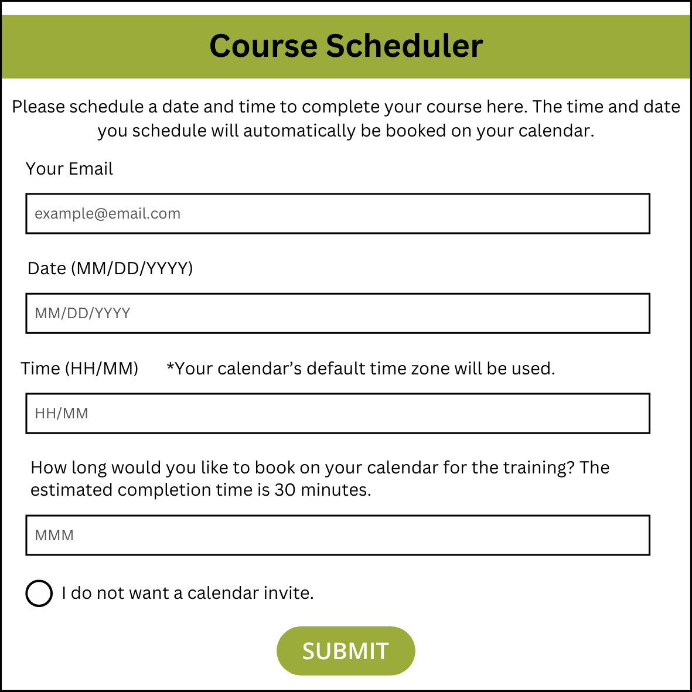
Solution Design Proposal
Pseudocode on Project Documentation

Slide 10
Open Questions
Are any current Learning Management Systems utilizing a program like the one I designed in an attempt to increase completion of asynchronous online learnings? I could not find any research on it nor have I seen it in my time in the Learning and Development field.
Are outside motivators (such as prizes) more useful in increasing the completion of online learnings than any software changes or reprimand from supervisors?
Would adult learners consider this program too invasive or just not helpful?

Slide 11
Works Cited
Karlsen, J. T., Balsvik, E., & Rønnevik, M. (2023). A study of employees’ utilization of microlearning platforms in organizations. The Learning Organization, 30(6), 760-776. doi:https://doi.org/10.1108/TLO-07-2022-0080
Şahin Muhittin, & Yurdugül Halil. (2022). Learners’ needs in online learning environments and third generation learning management systems (LMS 3.0). Technology, Knowledge and Learning, 27(1), 33-48. doi:https://doi.org/10.1007/s10758-020-09479-x

